Slide 1
Singular Value Decomposition (SVD)
Singular Value Decomposition (SVD) is a powerful and universal method of matrix decomposition. It breaks any matrix into three simpler, structured matrices that reveal its essential properties.

Slide 2
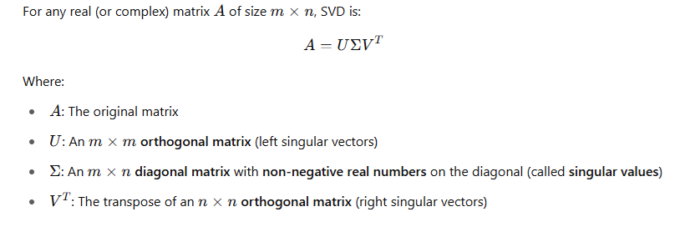
Singular Value Decomposition (SVD)

Slide 3
Singular Value Decomposition (SVD)
A matrix A is taken and it is transformed by rotating, stretching, flipping, etc. to new output matrices.
U:-It can be considered as the rotation of final result, each column in this matrix tells you a direction in the output space
∑:-The values on the diagonal (singular values) indicates how much to stretch or compress in each direction

Slide 4
SVD vs. Spectral Decomposition
Spectral decomposition is a special case of SVD that works only for square, symmetric matrices
SVD works for all matrices
Spectral decomposition is therefore a simpler version of SVD for special matrices

Slide 5
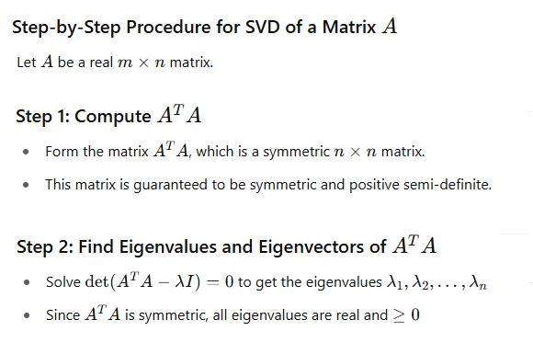

Slide 6
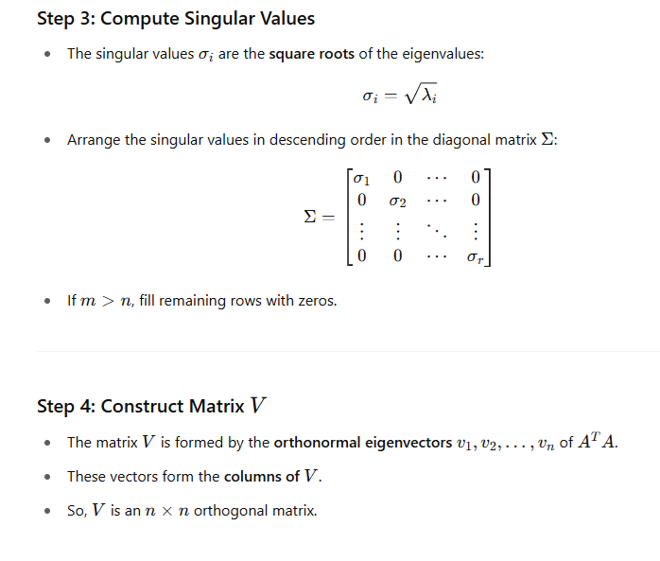

Slide 7
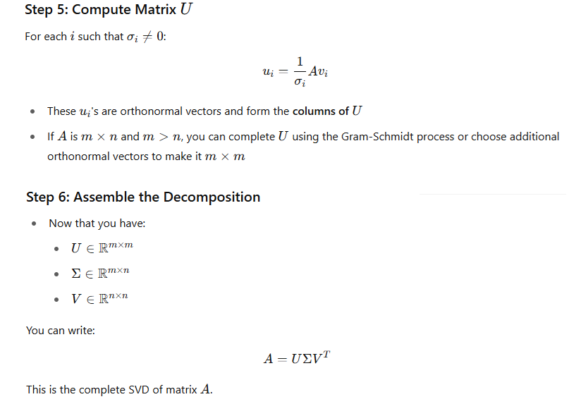

Slide 8
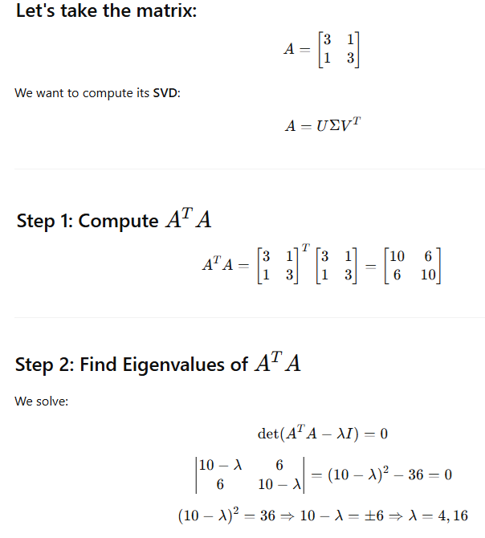

Slide 9
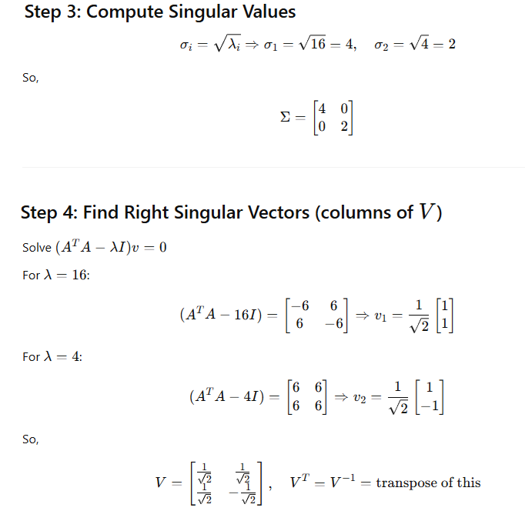

Slide 10
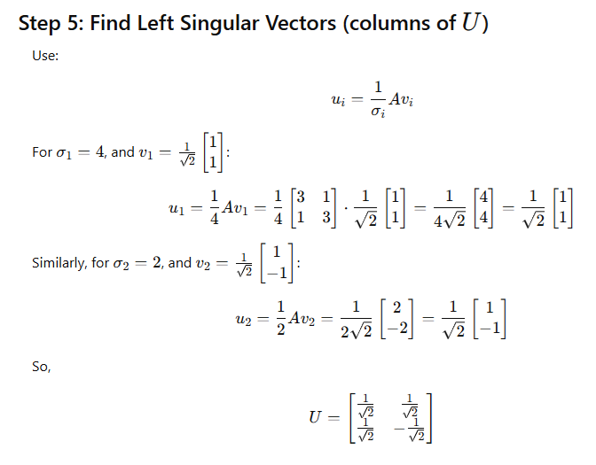

Slide 11
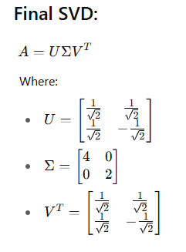

Slide 12
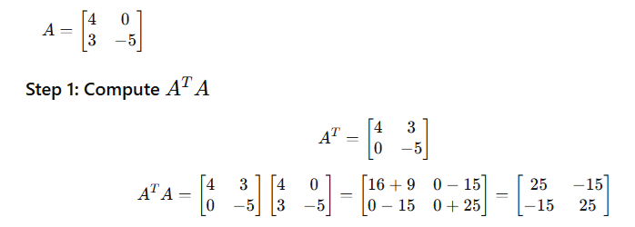
Another example

Slide 13
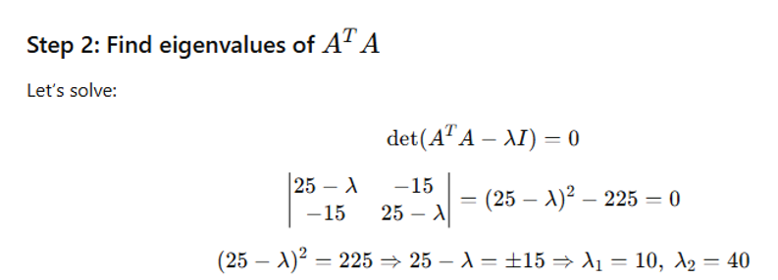

Slide 14
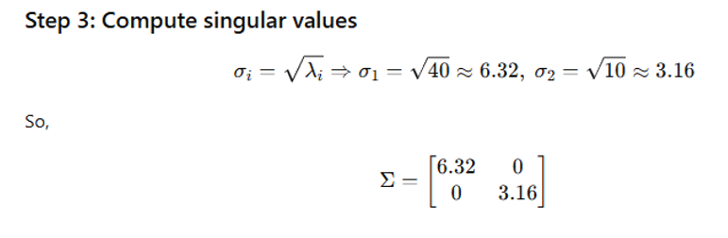

Slide 15
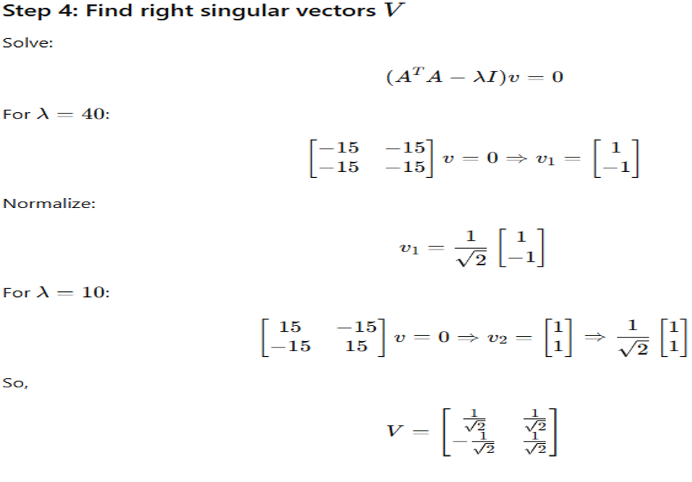

Slide 16
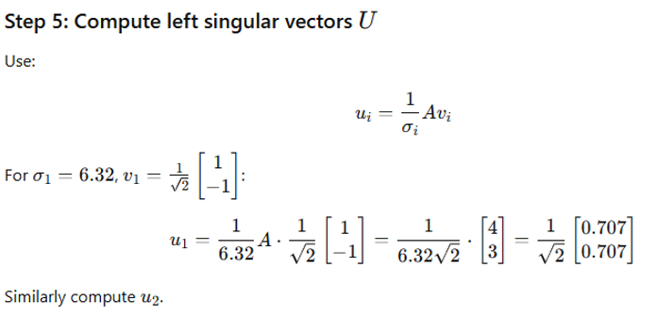

Slide 17
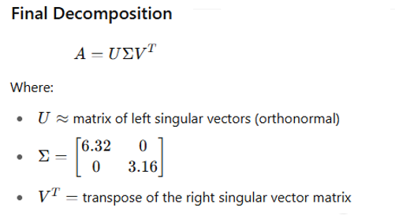

Slide 18
Applications of Singular Value Decomposition (SVD)
Dimensionality Reduction (Principal Component Analysis - PCA)
SVD helps identify the most important features (principal components) in data.
Reduces noise, improves computational efficiency, and helps with data compression.
Used in image compression, pattern recognition, and machine learning preprocessing.

Slide 19
Applications of Singular Value Decomposition (SVD)
2. Data Noise Filtering
SVD can separate signal from noise by keeping large singular values (signal) and discarding small ones (noise).
Especially useful in:
EEG/ECG signal denoising
Sensor data filtering
Financial time series smoothing

Slide 20
Applications of Singular Value Decomposition (SVD)
3. Recommender Systems
Singular Value Decomposition (SVD) is widely used in recommender systems to predict missing entries. In platforms like Netflix or Amazon, users rate only a few items, leaving many entries blank.
SVD decomposes this matrix into three components—user preferences, item features, and their importance—allowing us to identify hidden patterns between users and items.
By reconstructing the matrix using only the most significant features, SVD can estimate the missing ratings accurately. These predicted ratings help recommend new movies, products, or songs that a user is likely to enjoy, making SVD a powerful tool for personalized recommendation systems.

Slide 21
Dimensionality reduction
Dimensionality reduction is a key technique in modern data science and machine learning that addresses the challenges posed by high dimensional datasets.
As the number of input features increases, data becomes sparse and models become prone to overfitting, reduced interpretability, and longer training times — this is known as the curse of dimensionality.
Reducing dimensions is essential for improving model performance, simplifying data visualization, and enhancing generalization.

